Slide 1
Dating “The Marine Corps Colonel’s Daughter”
A dissection of what went right, and how to end up bayoneted at the age of 17

Slide 2

Overview
Part I: The Right Stuff
  Background
  The pursuit
  Standardized Operating Procedures
Part II: Down in flames
  What not to do
  Lessons Learned
    Good
    Bad

Slide 3
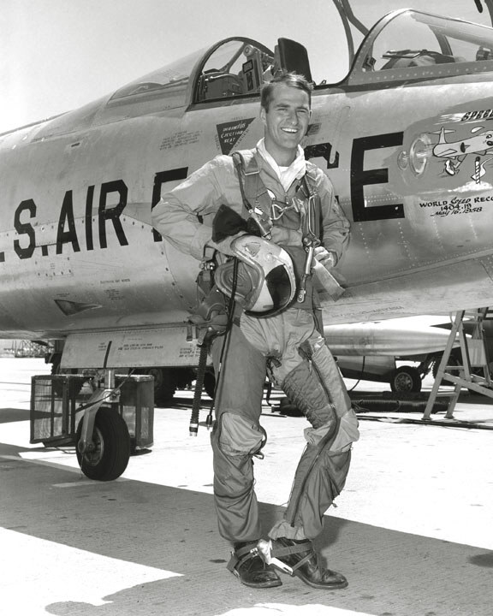
Part I: The Right Stuff

Slide 4
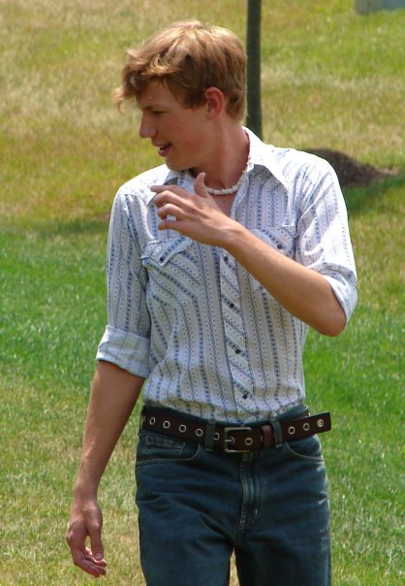
Background
17 years old, fall 2005
ACT prep class
Cross Country
Boredom/Starving
Doritos
Relaying messages
Phone number

Slide 5
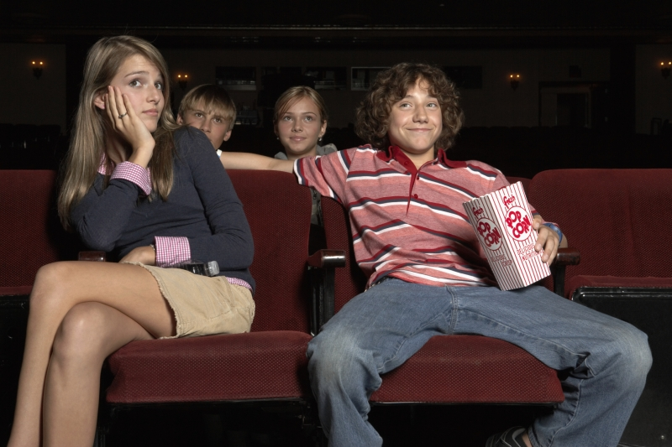
The Pursuit
Similarities
Trying to get a date
  Picnic
Introductions
  Family, Dog
Timing Standards
Manners
Acceptance

Slide 6
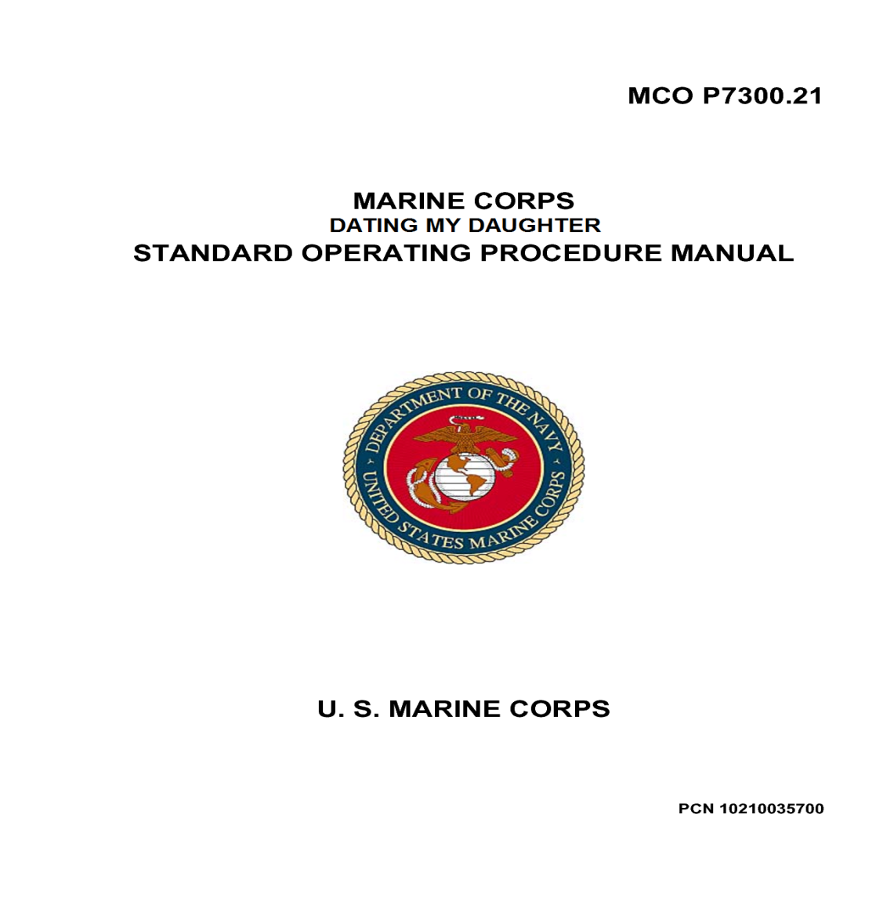
Standardized Operating Procedures
Parental Advisory’s
Communication may be monitored for quality assurance
Cinderella
Tight Leash

Slide 7

End of Part I
Instructional points
  Greater authority figure
  Strict rules
  Maintain the standard

Slide 8
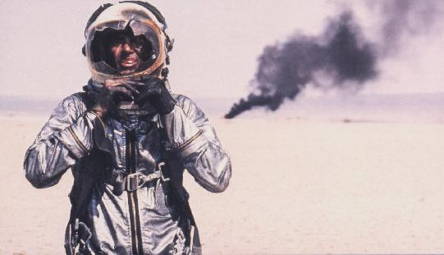
Part II: From the Halls of Montezuma to the floor of a closet.
What Not To Do!

Slide 9
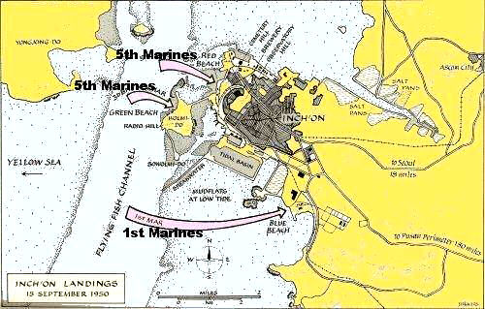
Prelude To Invasion
Receiving Orders
  Past bed time
Stepping off
E&E
Murphy’s Law
  Movie
  Blind Fold
  Movie

Slide 10
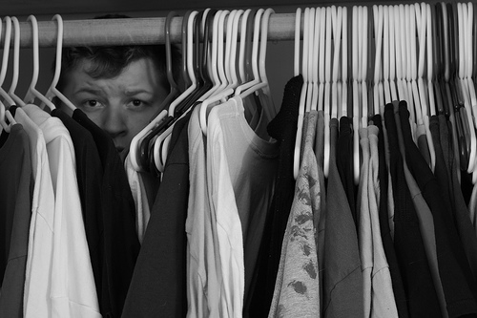
Praying for Narnia
The Alarm
Canine’s easily excited
Trapped in a closet
Is there anyway out?
  Denial
  Ceiling
  Wall
  Dresses
    Acceptance

Slide 11

Heaven Smiles Upon Thee
The Great Escape
Murphy’s Law Part II
  Friends
  Running
  Back into the breach
E&E Part II
Key to freedom
Shadows in the dark
Bat out of Hell

Slide 12
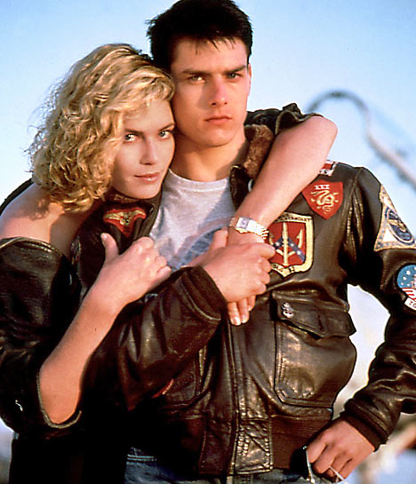
Lessons Learned: The Good
Mind your manners
Follow SOP’s
Common Sense

Slide 13
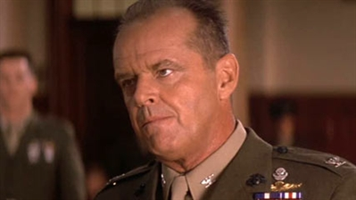
Lessons Learned: The Bad
Ignore SOP’s
  The Journey
Exit Strategy
  Be observant
Call it a loss
  Loss of gear is acceptable

Slide 14
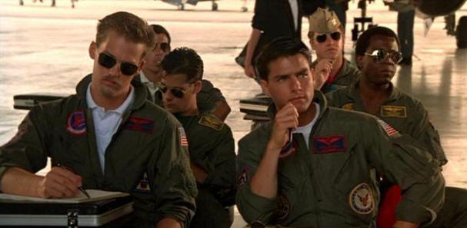
Summary
Part I: The Right Stuff
  Background
  The pursuit
  Standardized Operating Procedures
Part II: Down in flames
  What not to do
  Lessons Learned
    Good
    Bad

